Slide 1
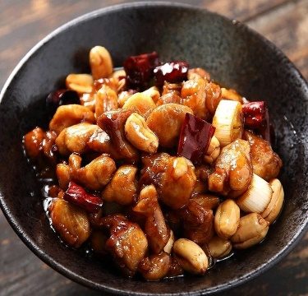
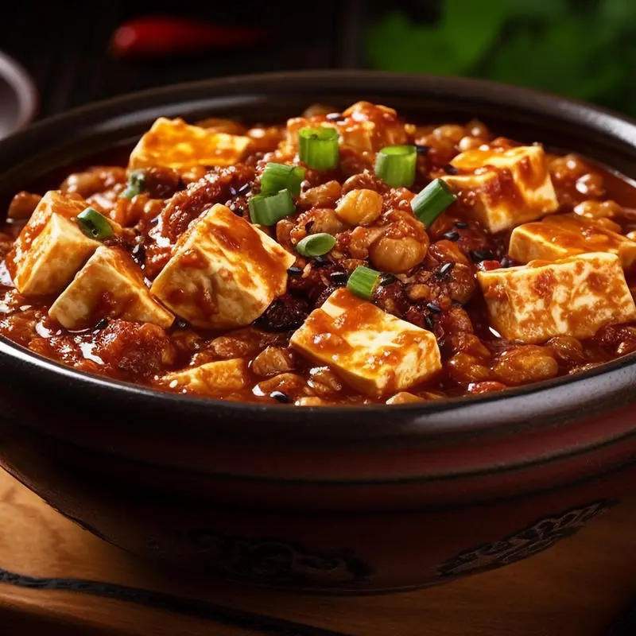
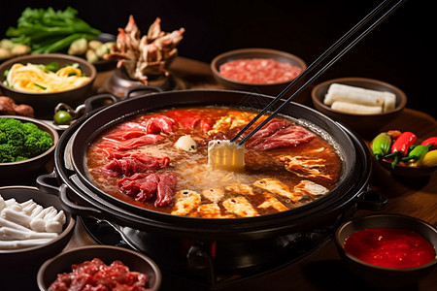
Confucius Institute at Comenius University
Shan Liu

Slide 2
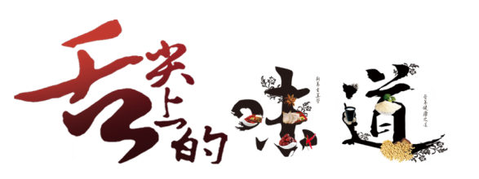
Sichuan Cuisine
01
Kung Pao Chicken 宫保鸡丁
02
Mapo Tofu 麻婆豆腐

Slide 3
行业PPT模板http://www.1ppt.com/hangye/
Sichuan Cuisine
Sichuan cuisine( 川菜Chuān Cài ), one of the Eight Great Cuisines in China, is a style of Chinese cuisine originating from the Sichuan province in southwestern China. It is known for its bold and spicy flavors, as well as the use of various aromatic and tongue-numbing spices.

Slide 4
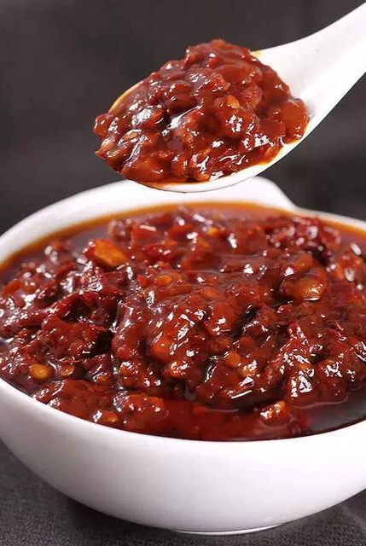
Má Là
(Numbing and Spicy)
Garlic and Ginger
Fermented Bean Paste
Stir-frying and Braising

Slide 5
01
KungPao Chicken
Kung Pao Chicken(Gōng bǎo jī ding), is a classic dish in Sichuan cuisine with a history dating back to the late Qing Dynasty in China. The dish is named after Ding Baozhen, a late Qing Dynasty official who held the title "Gong Bao" or "Kung Pao" during his service.
DELICIOUS FOOD

Slide 6
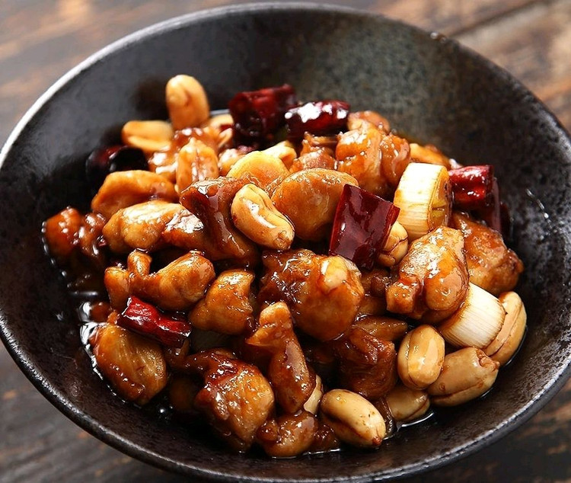
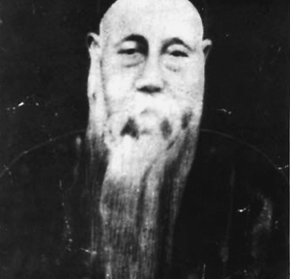
The story of KungPao Chicken
There are different stories about the origin of KungPao Chicken. One of them goes that Ding Baozhen was not only a respected official but also a gourmet who appreciated good food.
According to legend, he had a particular fondness for spicy and flavorful dishes. It is said that Kung Pao Chicken was one of his favorite dishes, and the chefs in his household would prepare it to satisfy his taste for bold and spicy flavors.
Over time, it became popular not only in Sichuan but also throughout China and eventually around the world.

Slide 7
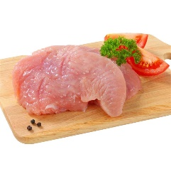
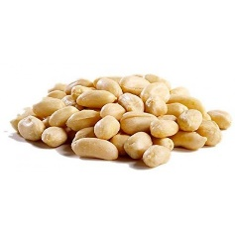
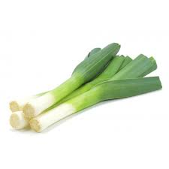
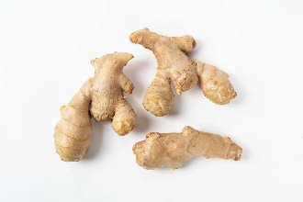
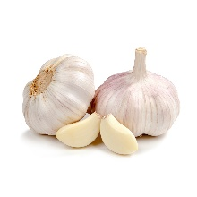
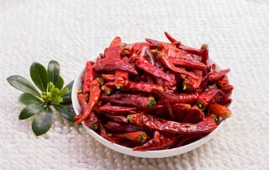
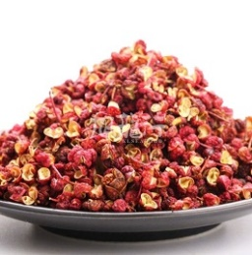
Ingredients:
500g boneless, skinless chicken breasts/legs, cut into 1.5cm cubes
100g Peeled and unsalted peanuts
15g Spring onion, 1.5 cm sliced
15g Ginger, sliced
15g garlic, sliced
15 dried red chili peppers, chopped (adjust according to your spice preference)
20 Sichuan paper
18-20g soy sauce
10g vinegar
25g green bean starch, mixed water
Few salt, 5-6g sugar
Vegetable oil
10g Shaoxing Wine/rice wine

Slide 8
KungPao Chicken
For the Marinade:
For the sauce:
3g soy sauce
3-5g Shaoxing wine
1-2g salt
Some green been starch
Few drops of oil
Spring onion, garlic, ginger
15g soy sauce
5g Shaoxing wine
10-15g vinegar
5-6g sugar
some green been starch with water

Slide 9
Instructions
1.Marinate the Chicken:
In a bowl, combine the chicken pieces with the marinade ingredients. Let it marinate for about 15-20 minutes.
2.Prepare the Sauce:
In another bowl, mix together the soy sauce, rice vinegar, sugar, and starch slurry. Set aside
3. Fry the peanuts
Put some oil into the wok and fry the peanuts with low heat until the peanuts turn to golden. Takt them out and set aside.
(Or stir-fry them with less oil and medium heat)

Slide 10
Instructions
4.Stir-fry the Chicken:
Heat some new oil in the wok with a high heat. Put the Sichuan pepper and dry chili pepper, stir-fry 5 seconds. Add the marinated chicken and stir-fry until it's cooked through and slightly browned
5.Add the Sauce:
Add the sauce by three times. Firstly add half sauce with ginger, garlic and spring onion, stir fry them for 1min. Add the second time and stir fry again for 1min. Add the rest sauce and stir fry.
6. Combine and finish
Add few drops of soy sauce and vinegar and add the fried peanuts, stir-fry everything together until well coated and heated through.

Slide 11
02
MaPo Tofu
Mapo Tofu(Má pó dòufu) is traditionally made with silken tofu, minced meat (usually beef), and a flavorful sauce that includes ingredients like chili bean paste, soy sauce, and Sichuan peppercorns. It's known for its complex combination of spiciness, numbing sensation
DELICIOUS FOOD

Slide 12
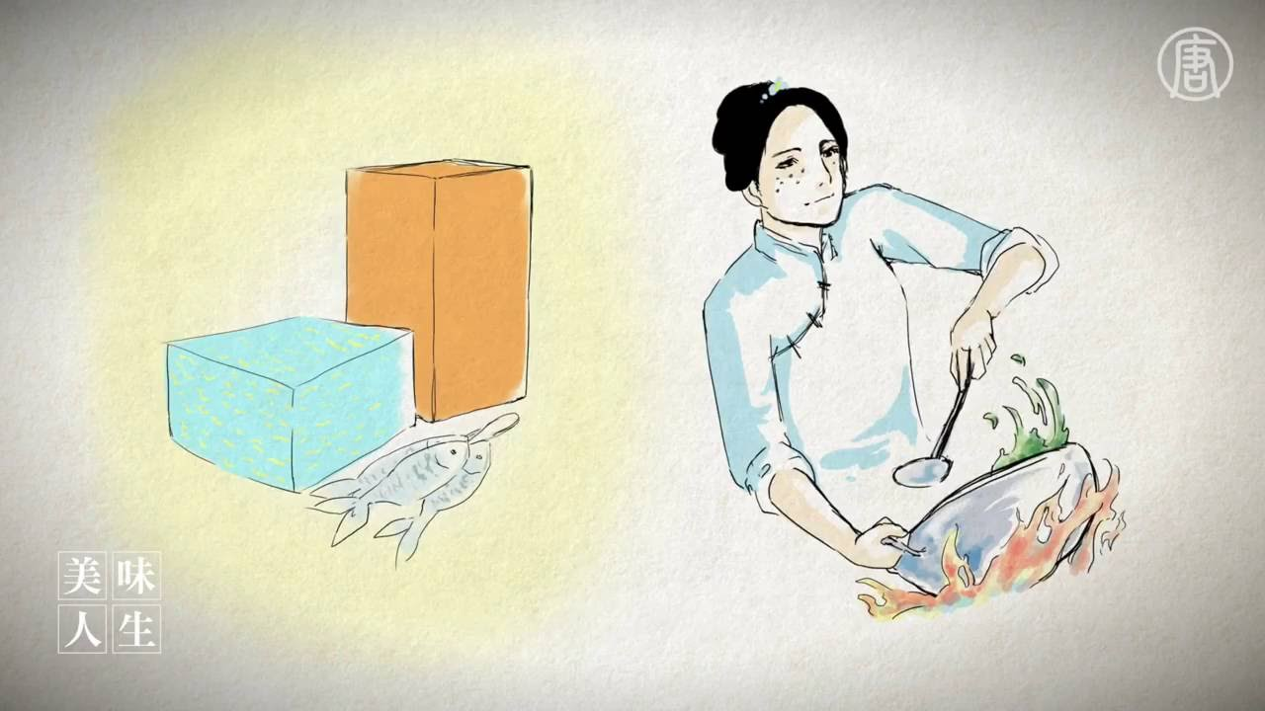
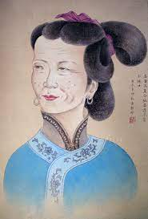
The story of MaPo Tofu
The story of Mapo Tofu is intertwined with Chinese folklore and culinary history. The dish is named after a woman known as Chen Mapo, who lived during the Qing Dynasty (1644-1912) in Chengdu, the capital of Sichuan province in southwestern China.

Slide 13
The legend goes like that:
Chen Mapo was a skilled and resourceful woman who ran a small restaurant. She was known for her pockmarked face, which earned her the nickname "Mapo," meaning "pockmarked lady." Despite her appearance, she was famous for her exceptional cooking skills.
One day, some workers arrived at Chen Mapo's restaurant. They were tired and hungry, seeking a hearty and flavorful meal. There wasn’t much food and ingredients left so Chen Mapo she used the limited ingredients she had on hand: tofu, minced meat, and a bold combination of Sichuan peppercorns and chili peppers.
The result was a spicy and numbing dish that left a lasting impression on those people. This dish got more and more popular and was named "Mapo Tofu," referring to Chen Mapo and the pockmarks on her face.
Over time, Mapo Tofu gained popularity not only in Chengdu but also throughout Sichuan and eventually across China. The dish became a staple of Sichuan cuisine, celebrated for its fiery and numbing flavors.

Slide 14
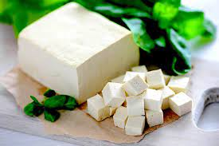
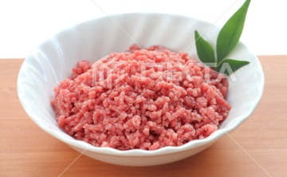
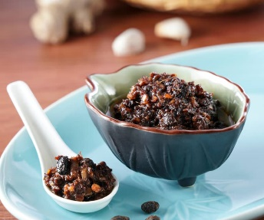
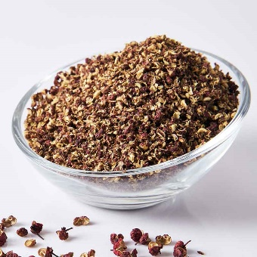
Ingredients:
400g silken tofu, cut into 1-inch cubes
1/4 cup vegetable oil
200g ground beef
2 tablespoons chili bean paste (doubanjiang)
1 tablespoon fermented black beans, rinsed and minced
2 teaspoons Sichuan peppercorns, toasted and ground
2 tablespoons soy sauce
1 tablespoon sugar
1 tablespoon chili powder
2 tablespoons cornstarch with water, mixed
2 green onions, sliced (for garnish)
1 teaspoon sesame oil (optional)

Slide 15
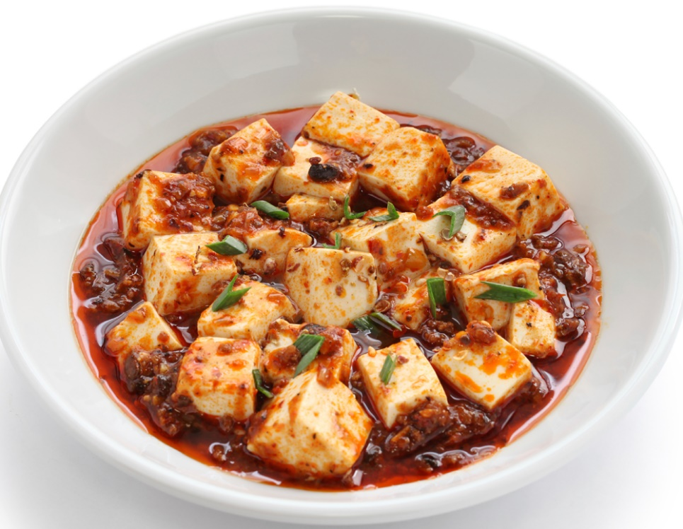
Instructions
1.Prepare the Tofu:
Carefully cut the tofu into 1-inch cubes. Gently boil the tofu cubes with few salt in hot water for about 3-4 minutes to heat through. This helps the tofu absorb the flavors of the dish without breaking apart. Drain and put Tofu into the cold water and set aside.
2. Cook the Meat:
Heat vegetable oil in a wok or large skillet over medium heat. Add the ground beef and cook until it's browned and cooked through.
3. Add Flavoring Ingredients:
Add the chili bean paste, fermented black beans and the chili powder to the cooked meat. Stir well to combine and cook for 1-2 minutes until fragrant. Add water, soy sauce, salt, sugar and boil with high heat

Slide 16
Instructions
4. Add Tofu and Sauce:
Gently add the boiled tofu cubes to the wok. Be careful not to break the tofu. cook for about 5-7 minutes, allowing the tofu to absorb the flavors of the sauce.
5. Add Cornstarch:
Add the mixed cornstarch water by three times. Each time carefully stir to coat the tofu with the sauce.
6. Finish and Garnish:
Taste and adjust the seasoning if needed. Transfer the food into the place and sprinkle some ground Sichuan peppercorns. Optionally, add a teaspoon of sesame oil for additional flavor. Garnish with sliced green onions.

Slide 17
Thank you

