Slide 1
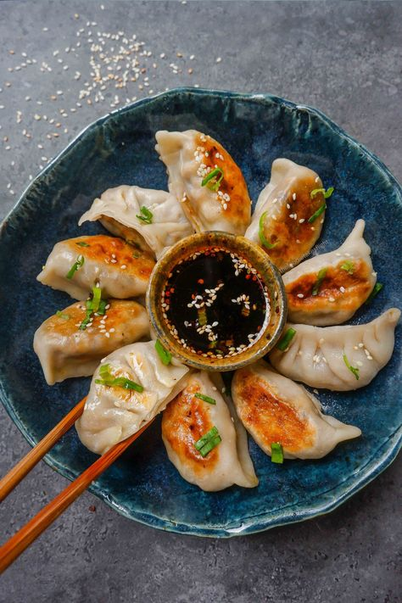
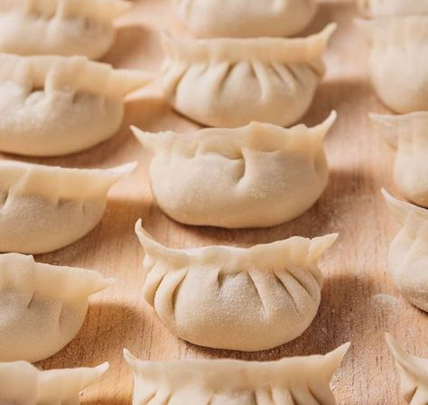
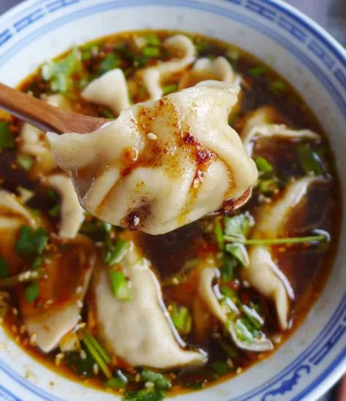
Confucius Institute at Comenius University
Wang Shuhuai & Ling Wei & Lu Shuang

Slide 2
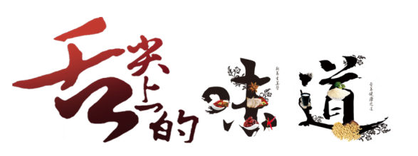
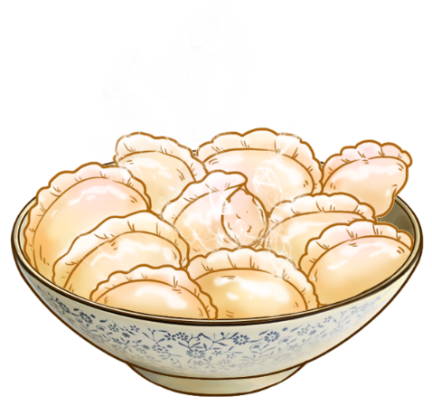
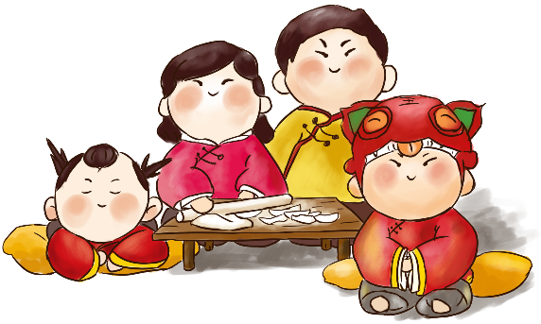
行业PPT模板http://www.1ppt.com/hangye/
Sichuan Cuisine
Jiaozi, also known as Chinese dumplings, are a traditional Chinese food that is loved by people all over the world. They are made by wrapping minced meat and vegetables in a thin dough wrapper, and then boiled, steamed, or pan-fried until cooked.
jiǎo zi
wǒ xǐ huān chī jiǎo zi
饺 子
我喜欢吃饺子。

Slide 3
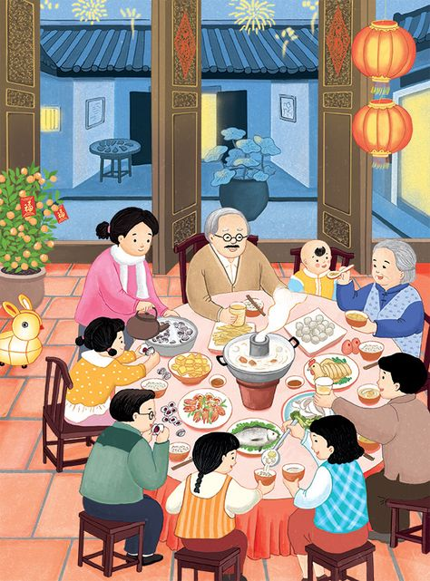
01
History of Jiaozi
- Jiaozi can be dated back to Song Dynasty, between 500 and 600 years.
- Jiaozi are made specifically to celebrate the Chinese New Year, which marks the start of a new year.
- These tasty treats are used as symbols to designate personal wishes and desires for the new year.

Slide 4
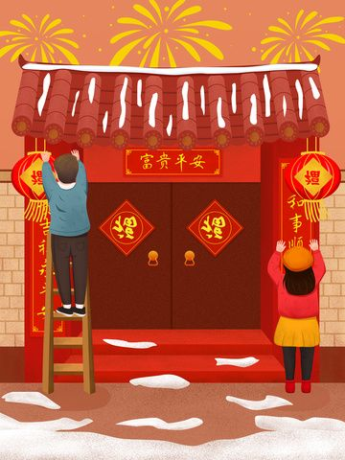
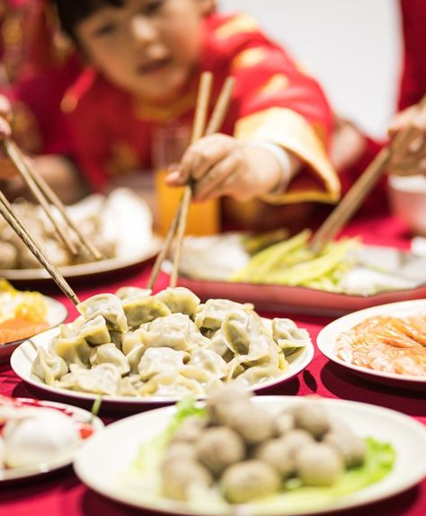
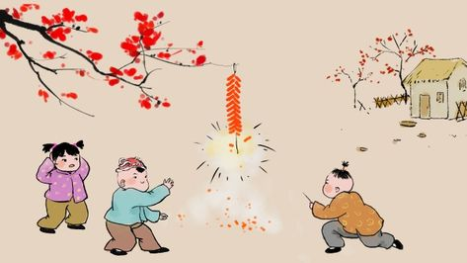
Tradition
[Spring Festival]
02
- Chinese New year is the longest and most important festivity in the Chinese Calendar. The origin of Chinese New Year is itself centuries old and gains significance because of several myths and traditions.
- Ancient Chinese New Year is a reflection on how the people behaved and what they believed in the most.

Slide 5
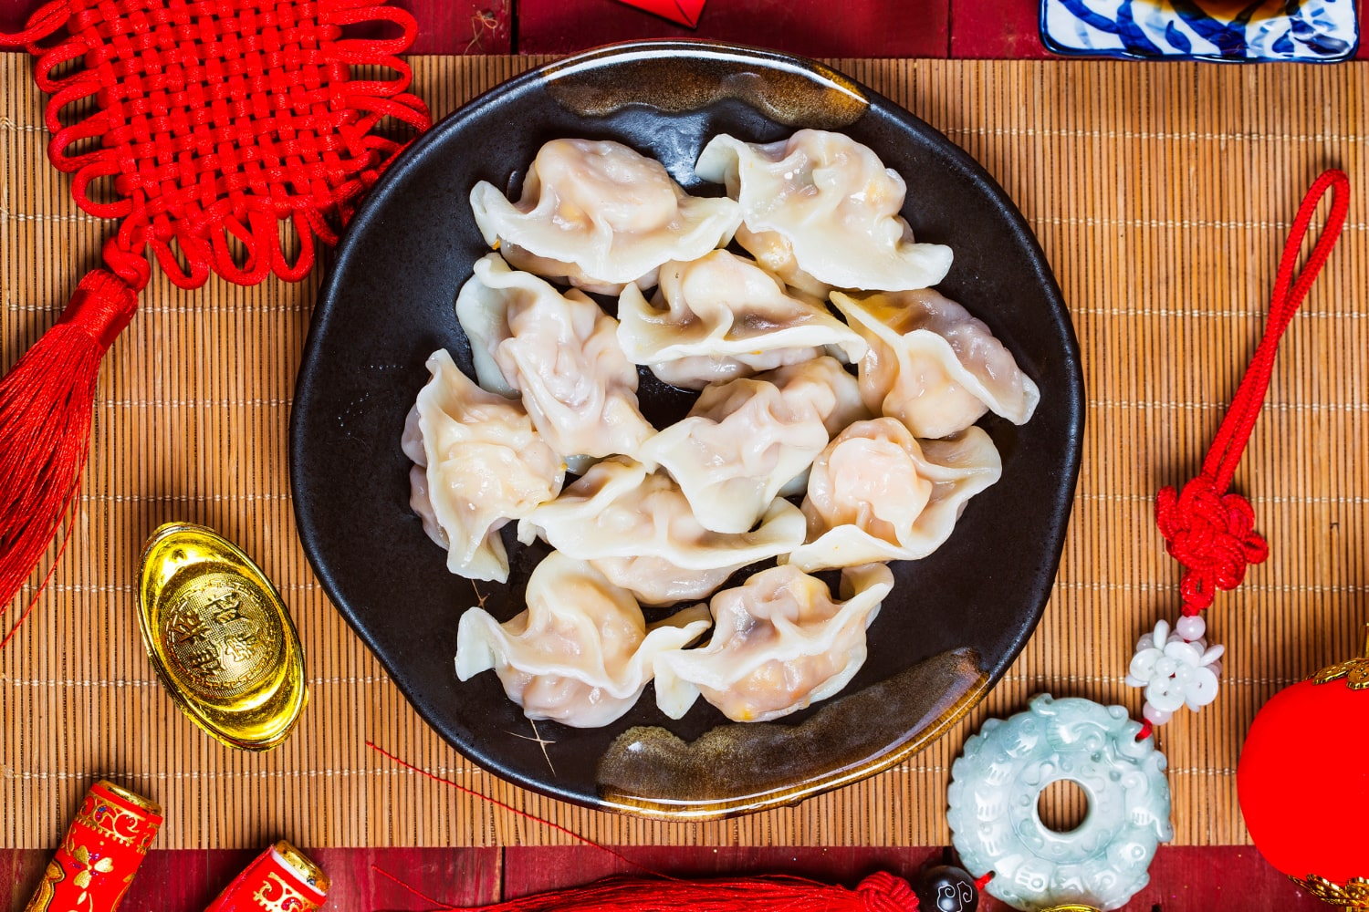
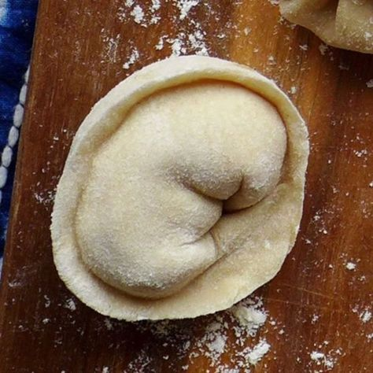
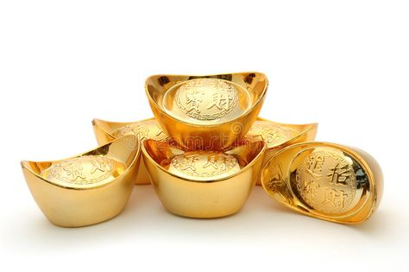
- Chinese Jiaozi is one of the most important foods in Chinese New Year. Since the shape of Jiaozi is similar to the ancient Chinese gold or silver ingot, they symbolize wealth.
- Traditionally, the members of a family get together to make Jiaozi during the New Year’s Eve. They may hide a coin in one of the Jiaozi. The person who finds the coin will likely have a good fortune in the New Year.

Slide 6
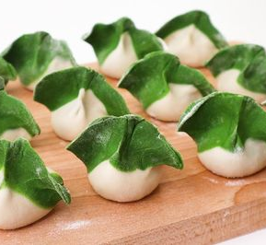
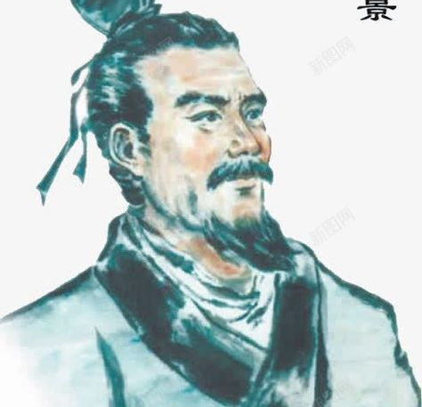
03
Folk of Jiaozi
According to folk tales, in the old days, Jiaozi were often eaten in memory of Doctor Zhang Zhongjing, one of the greatest practitioners of traditional Chinese medicine in history. At that time, Jiaozi was used as medicine. Zhang Zhongjing used the crust to wrap some herbs which could ward off cold to treat frostbite on people's ears. Later, it was gradually used for food.

Slide 7
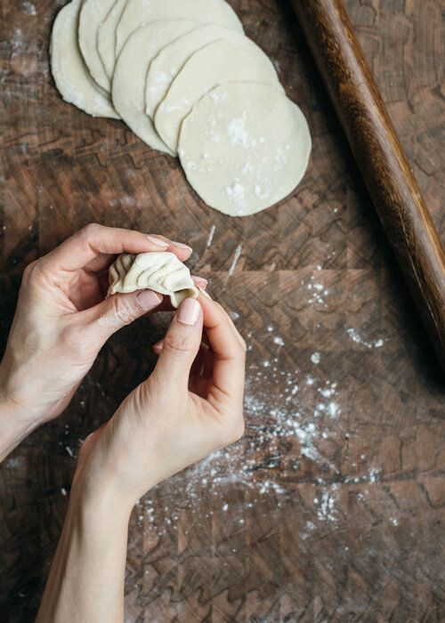
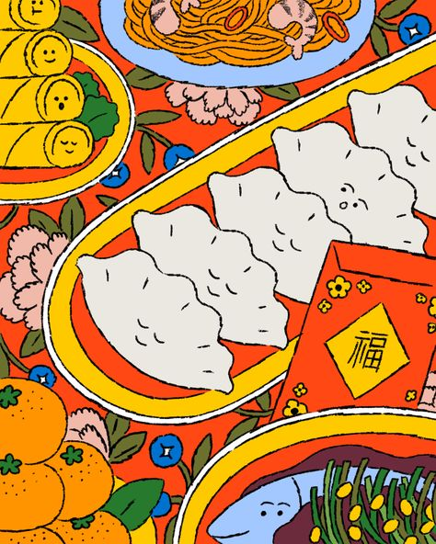
04
Present
Jiaozi are eaten all year round and can be eaten at any time of the day – breakfast, lunch or dinner. They can constitute one course, starter or side dish, or the main meal. Every family has its own preferred method of making them, with favourite fillings, and of course, jiaozi types and preparation vary widely according to region.

Slide 8
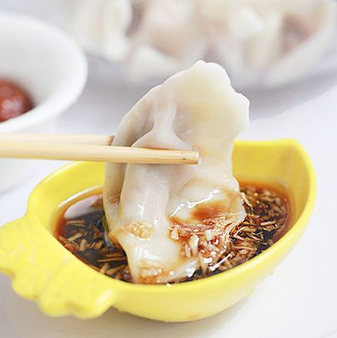
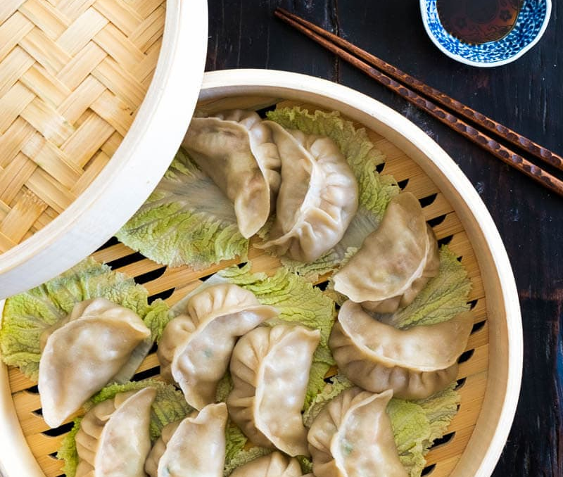
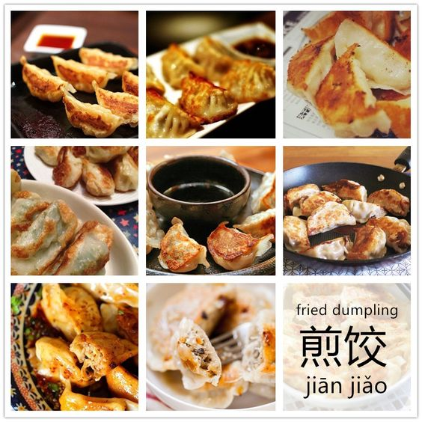
Classic Chinese Jiaozi
Shui Jiao: Boiled Jiaozi for All Seasons
Shui Jiao is typically served with various dipping sauces, such as soy sauce, vinegar, chili oil, or a combination, enhancing their flavors. These boiled Jiaozi are beloved for their comforting and satisfying qualities.
Zheng Jiao: steamed Jiaozi
Zheng jiaos are usually filled with a combination of minced meat and vegetables, and steamed to doneness in a bamboo round to retain the fresh flavors of the ingredients.
Guo Tie or Jian jiao: Crispy and Juicy Pan-Fried Jiaozi
Guo Tie, also known as Jianjiao, are a delightful variation of Chinese dumplings that are pan-fried to achieve a crispy bottom and juicy filling. They are made with a similar dough and filling as jiaozi, but the cooking technique sets them apart.

Slide 9
05
How to make Shuijiao
DELICIOUS FOOD

Slide 10
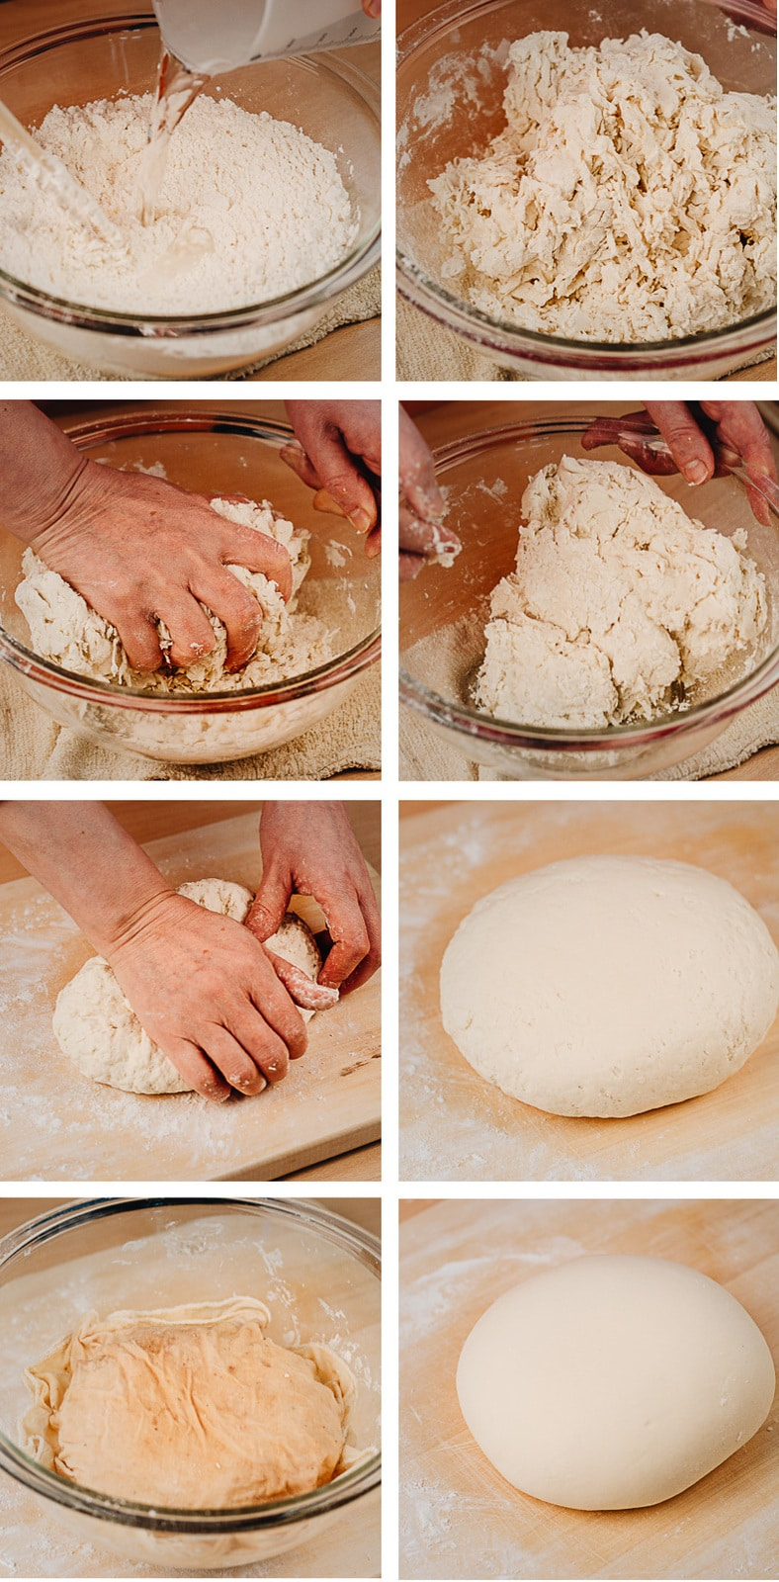
MAKING THE DOUGH
Pour 500g flour into a large mixing bowl and stir the flour as you slowly add water. (The ratio of flour to water is 2:1)
Stir the flour until it starts to cake.
Next put the dough onto a floured surface and knead it for around 10 minutes until it is smooth and soft.
Wrap the dough in cling film for an hour or so to let the dough rest.

Slide 11
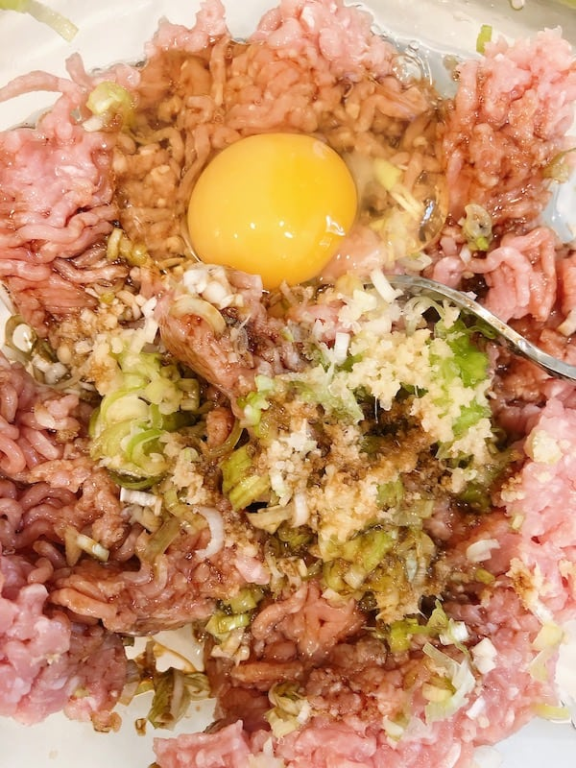
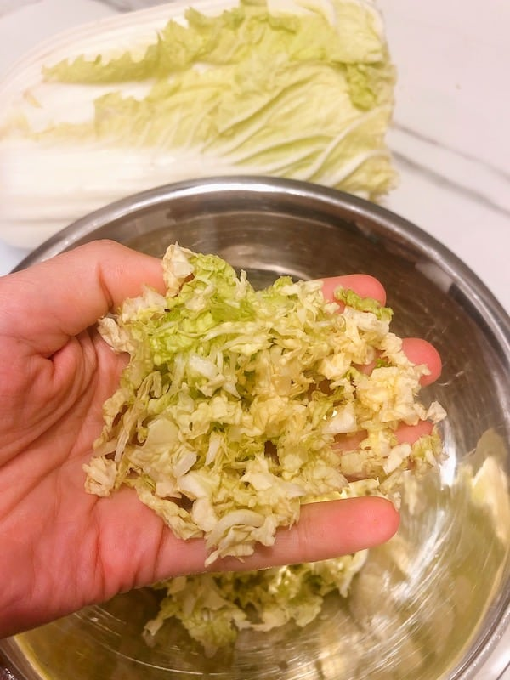
MAKING THE FILLING
Ingredients:
500g minced meat
500g Chinese cabbage
30g green onion
10g sesame oil
20g ginger
45g cooking wine
5g thirteen-spices
30g light soy sauce
20g dark soy sauce
5g salt

Slide 12
Mix all the ingredients together except the cabbage and stir it in the same direction to form a thick consistency.
While the meat is marinating, you can prepare the Chinese cabbage. Cut the cabbage across in thin slices, then chop the slices up into tiny pieces.
Put the cabbage in a bowl and sprinkle with 1 teaspoon of salt and set aside for 30 minutes. Now squeeze out any excess water from the cabbage before you add it to the meat mixture.
Mix the cabbage into the meat mixture.

Slide 13
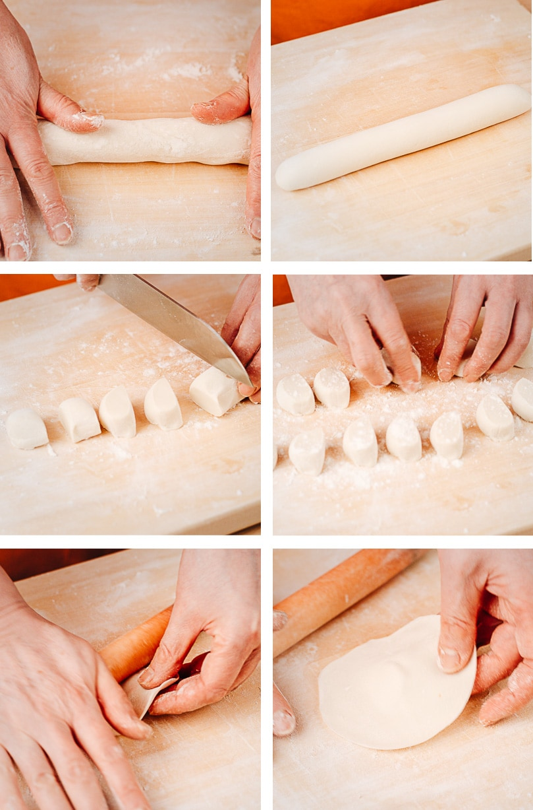
MAKING THE WRAPPERS
Knead the dough: sprinkle some flour on cutting board, take out the dough and knead it for a while.
Cut the dough: cut the dough in half, knead and roll the dough into a long strip, and make sure the thickness is even. Cut the dough into even pieces with a knife and use some flour on them.
Roll out small dosages: roll the small pieces of dough by hand into a round small dosage.

Slide 14
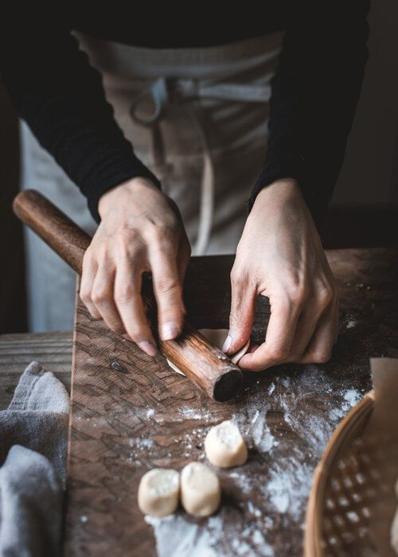
4. Turn dosages into wrappers:
Sprinkle appropriate amount of flour on the panel.
Hold the rolling pin in the right hand, hold the dough in the left hand.
Push the rolling pin to press the dough with the right hand.
Turn the dough with the left hand.
Repeat until the dough is pressed into a circle with thick middle and thin sides.

Slide 15
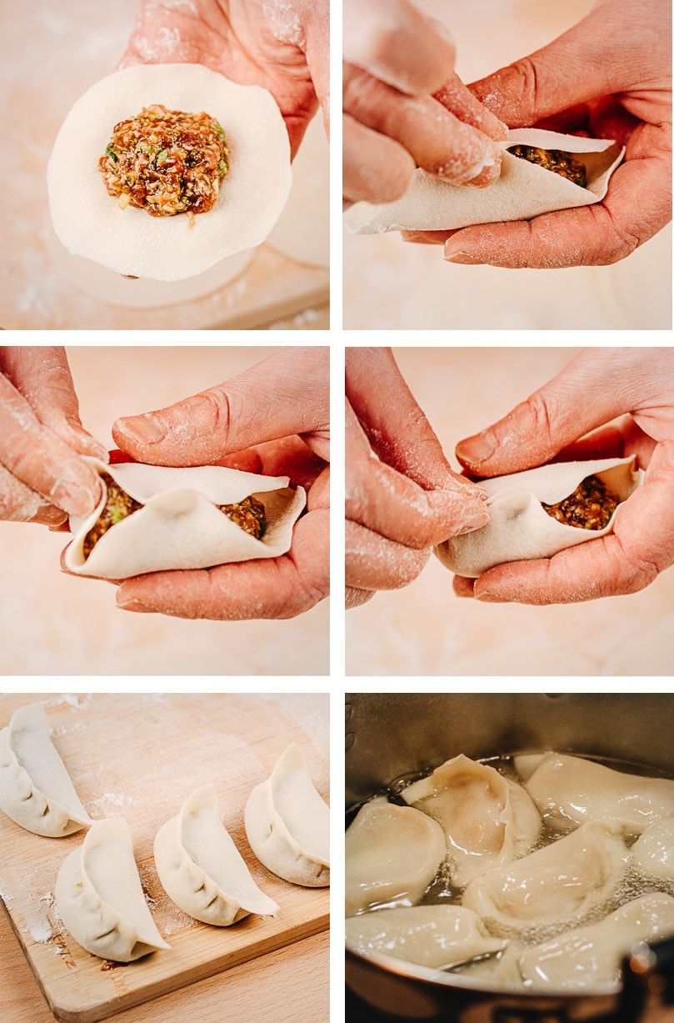
FOLDING JIAOZI
Take a wrapper and place it in the palm of your hand. Next take a tablespoon of filling and place it in the middle of the wrapper.
Fold the wrapper over and pinch the edges together to seal it.
Place the Jiaozi on a tray with the pinched edges facing up and pinch a few pleats in the Jiaozi to create a pouch.

Slide 16
BOILLING JIAOZI
Boil the water.
Pour the Jiaozi into the water, be careful not to put too much once.
Stir the hot water with a shovel immediately, so that the jiaozi would not stick to the bottom of the pot.
Put a lid on the pot and wait for the water to boil and the jiaozi all to float up, which is to ensure they are fully cooked.
Remove the lid and continue to boil until the dumplings are puffy.

Slide 17
Thank you

